Slide 1




Eyal Vardi
CEO E4D Solutions LTD Microsoft MVP Visual C# blog: www.eVardi.com

Slide 2
Agenda
Intro
HTML5 Thinking
Offline / Storage
Communicating
File / Hardware Access
Multimedia / Graphics
CSS 3.0
Mobile

Slide 3
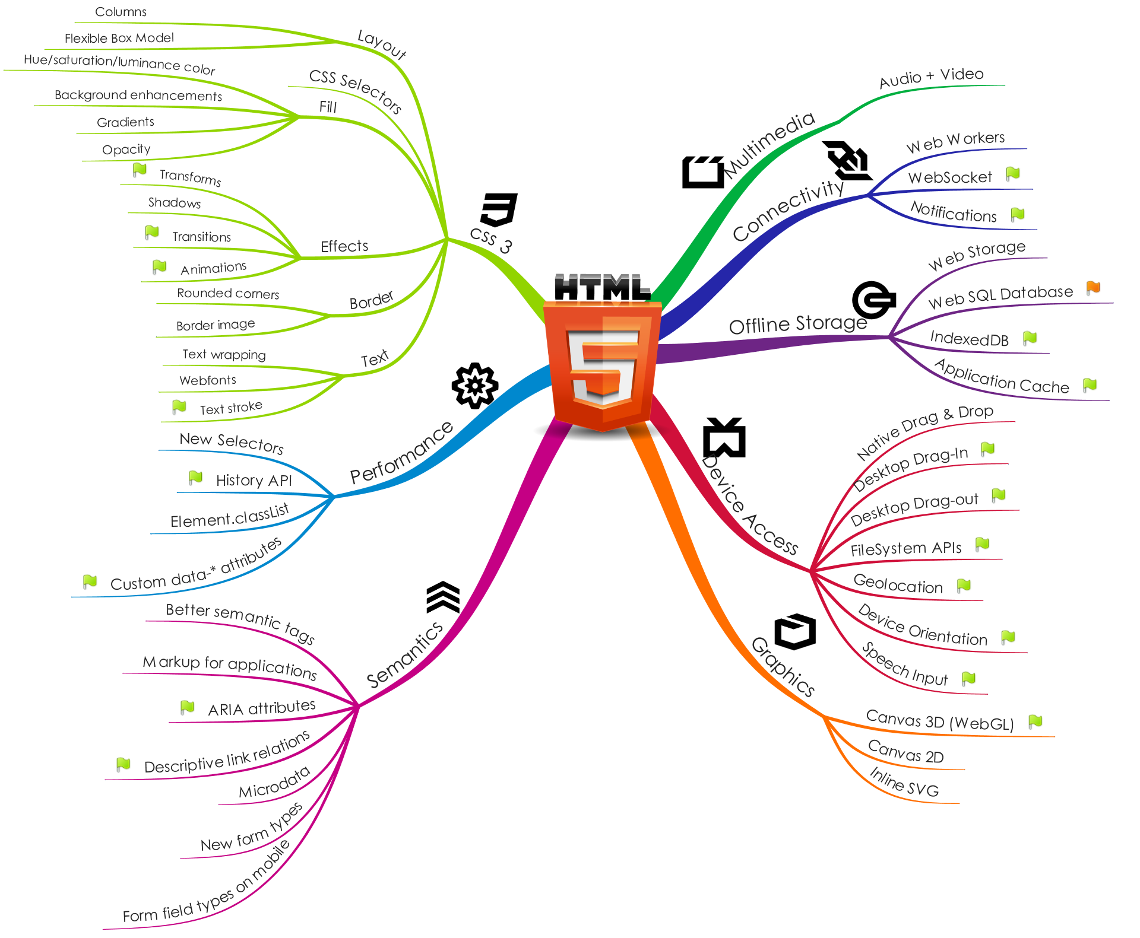

Slide 4
Web Technologies Timeline
1991 – HTML
1994 – HTML 2
1996 – CSS1 + JavaScript
1997 – HTML 4
1998 – CSS 2
2000 – XHTML 1
2002 – Tableless Web Design
2005 – AJAX
2009 - HTML 5

Slide 5
~ = + +
HTML 5
HTML
CSS
JS

Slide 6
Tools of the Trade
Javascript
JQuery and JQuery Mobile
CSS
Browsers
When can I use... (caniuse.com)
HTML5Test.com

Slide 7

HTML 5 Storage API

Slide 8
Before HTML5
Cookies
Flash Storage
Internet Explorer UserData
Google Gears
Dojo Storage
window.name ( hack )

Slide 9
Web Storage (localStorage/sessionStorage)
Store unstructured data
Store miscellaneous data (user/game/app pref)
Use cases of cookies but saving HTTP requests

Slide 10
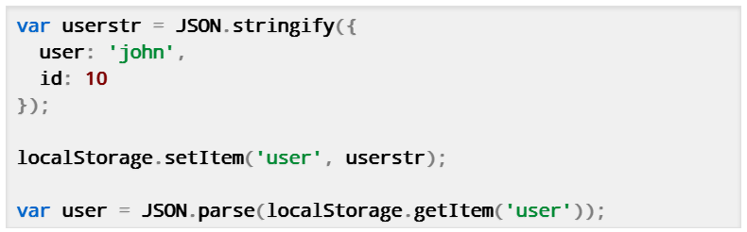
Local Storage
Only store strings!

Slide 11
Local Storage
localStorage for simple key-value storage
Easy API
setItem()
getItem()
removeItem()
clear()
if( !localStorage.getItem("checkins") )
{
localStorage.setItem("checkins", JSON.stringify([]));
}

Slide 12
Local Storage
// use localStorage for persistent storage // use sessionStorage for per tab storage saveButton.addEventListener('click', function () { window.localStorage.setItem('value', area.value); window.localStorage.setItem('timestamp', (new Date()).getTime()); }, false); textarea.value = window.localStorage.getItem('value');
Save text value on the client side (crash-safe)

Slide 13
Session Storage
window.sessionStorageSame as localStorage but...
Lasts as long as browser is open
Opening page in new window or tab starts new session
Great for temporal data (e.g. form progress)

Slide 14
Web SQL Database
Store structured data
Handle simultaneous data operations (with transactions)
var db = window.openDatabase( "DBName", "1.0", "description", 5*1024*1024 ); //5MB
db.transaction( function(tx) { tx.executeSql( "SELECT * FROM test", [], successCallback, errorCallback ); } );

Slide 15
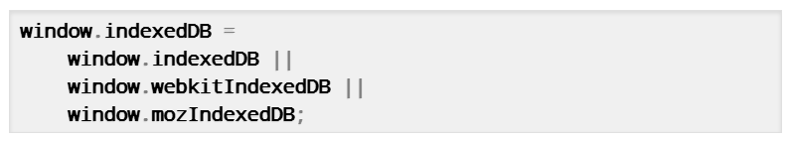
IndexedDB
Currently only Chrome and Firefox have implemented IndexedDB.
Today, it's supported via vendor prefixes. Let's simplify this:
var idbRequest = window.indexedDB.open('Database Name'); idbRequest.onsuccess = function(event) { var db = event.srcElement.result; var transaction = db.transaction([], IDBTransaction.READ_ONLY); var curRequest = transaction.objectStore('ObjectStore Name').openCursor(); curRequest.onsuccess = ...; };

Slide 16
IndexedDB
Instead of using SQL, you query an index, obtain a cursor, and iterate on the result set.
An index is a structure that speeds up the retrieval of data retrieval operations.
A cursor is a control structure that enables traversal over a database result. They are the database equivalent of iterators.
The result set is the collection of objects that matched a particular query.

Slide 17
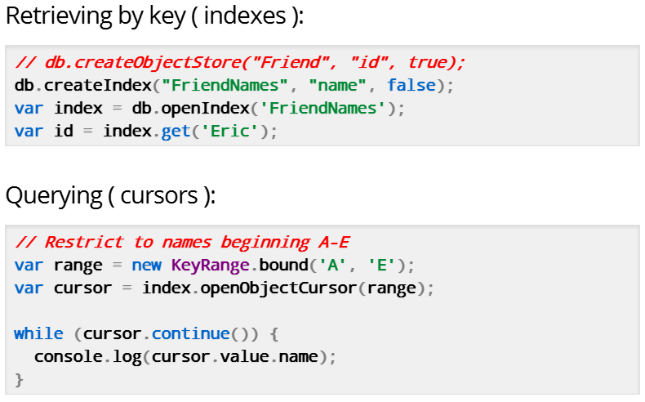
Finding Things

Slide 18
WebSQL?
Targeting mobile devices?
Use Lawnchair

Slide 19
Application Cache
Caches entire web app locally!
Why?
HTML, CSS, and JS stay fairly consistent
Native browser caching is unreliable
Caching resources creates speedier apps!
Used by iPhone & Android GMail app
Decent mobile support

Slide 20
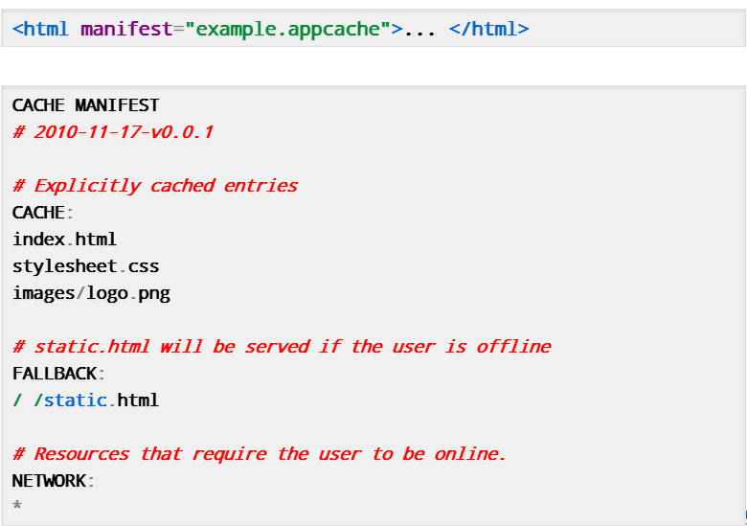
Application Cache

Slide 21
Apps using offline features
Offline Google Mail
NYTimes
Read Later Fast
Scratchpad

Slide 22
App Cache Gotchas
html docs w/ appcache are cached
Serve with mime-type: text/cache-manifest
just one 404 → nothing is cached
Syntax errors in the manifest cancels cache (use validator)
Must rev manifest to update resources
Update is served on 2nd reload (see next slide)
appcachefacts.info
Manifest file generator tool

Slide 23
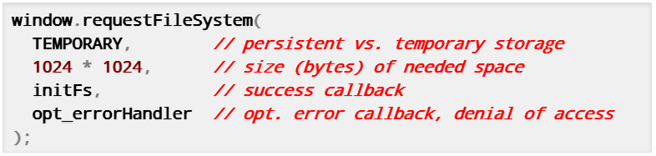
File System

Slide 24
Quota
 | Website | Web App with manifest
localStorage | 2.5Mb/5Mb | 2.5Mb/5Mb
sessionStorage | Unlimited | Unlimited
IndexedDB | 5Mb | Unlimited
App Cache | 5Mb | Unlimited
WebSQL | 5Mb | Unlimited
File System API | 5Mb | Unlimited

Slide 25
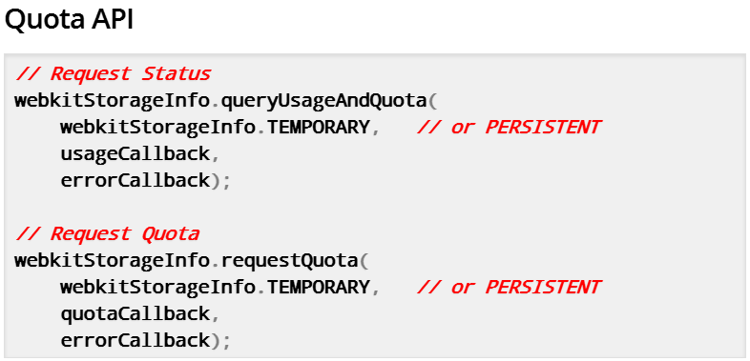
Quota API

Slide 26

Storage API

Slide 27

Connectivity

Slide 28
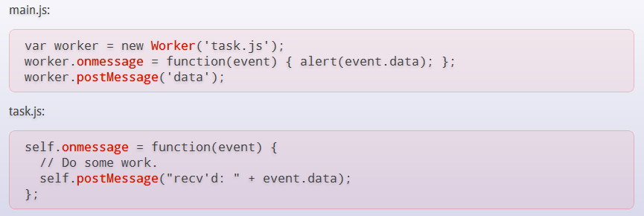
Web Workers
A web worker is a JavaScript running in the background, without affecting the performance of the page.
Notes:
http://www.w3schools.com/html5/html5_webworkers.asp

Slide 29
WebSocket
Full-duplex, bi-directional communication over the Web:
Both the server and client can send data at any time, or even at the same time.
Only the data itself is sent, without the overhead of HTTP headers, dramatically reducing bandwidth.
var socket = new WebSocket('ws://html5rocks.websocket.org/echo'); socket.onopen = function(event) { socket.send('Hello, WebSocket'); }; socket.onmessage = function(event) { alert(event.data); } socket.onclose = function(event) { alert('closed'); }

Slide 30
Real Time Communication with SignalR
Client to Server persistent connection over HTTP
Easily build multi-user, real-time web applications
Allows server-to-client push and RPC
Built async to scale to 000’s of connections
Auto-negotiates transport:
WebSockets (ASP.NET 4.5 on Windows 8)
Server Sent Events (EventSource)
Forever Frame
Ajax Long Polling
Open Source on GitHub (https://github.com/signalr/)

Slide 31
Chat with SignalR Hubs
public class Chat : Hub {
public void SendMessage(string message) {
Clients.addMessage(message);
}
}
var hub = $.connection.chat;
hub.addMessage = function (msg) {
$("#msgs").append("<li>" + msg + "</li>");
};
$.connection.hub.start().done(function() {
$("#send").click(function() {
hub.sendMessage($("#msg").text());
});
});

Slide 32
SignalR

Slide 33
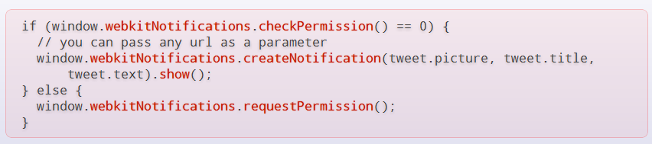
Notifications
The Notifications API allows you to display notifications to the user for given events, both passively (new emails, tweets or calendar events) and on user interactions regardless of which tab has focus. There is draft spec but it is not currently in any standard.
Notes:
http://www.html5rocks.com/en/tutorials/notifications/quick/

Slide 34

Semantics & Markup

Slide 35
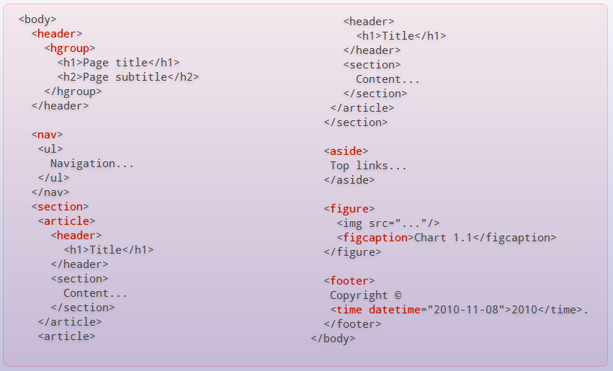
Better Tags
Notes:
http://www.w3schools.com/html5/html5_new_elements.asp

Slide 36
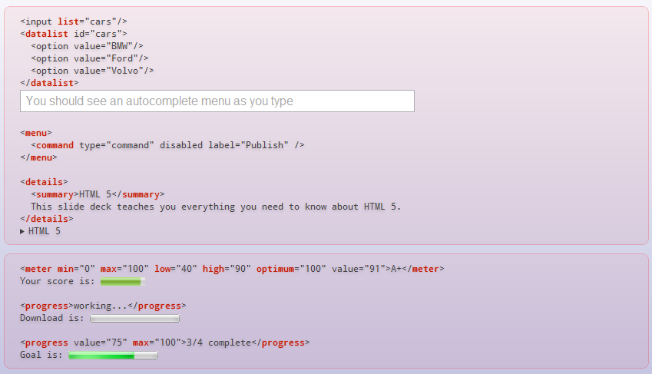

Slide 37
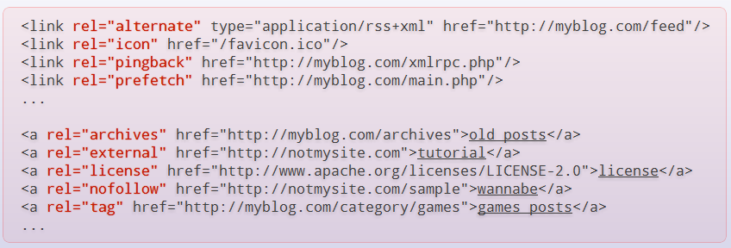
Link Relations

Slide 38
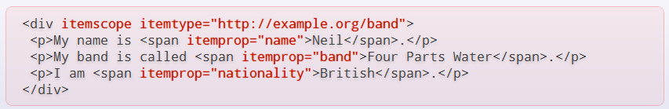
MicroData

Slide 39
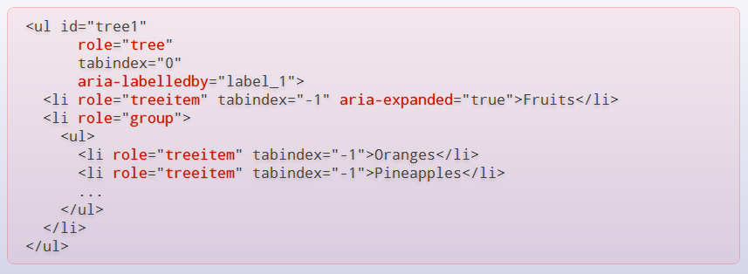
ARIA Attributes

Slide 40
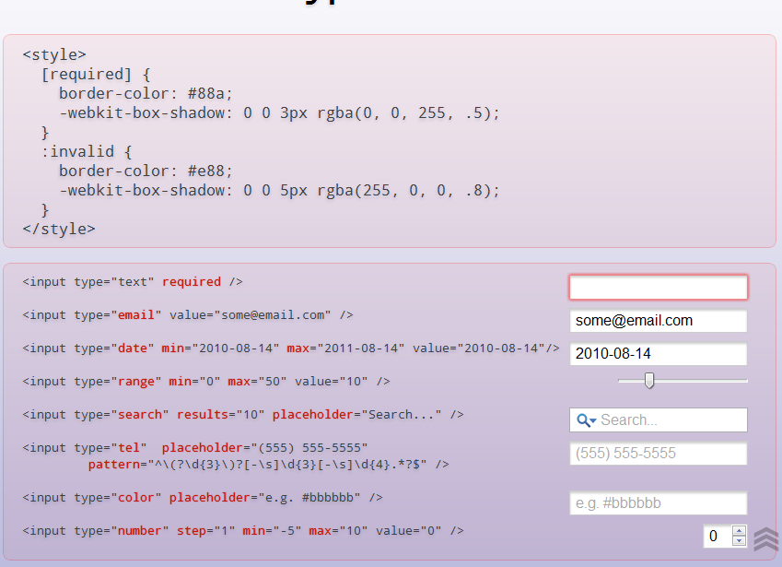

Slide 41
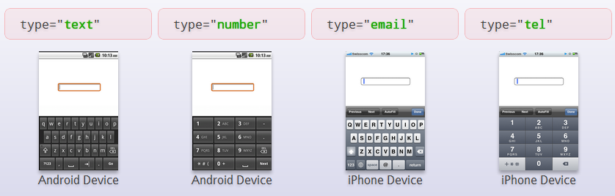
Mobile Fields

Slide 42
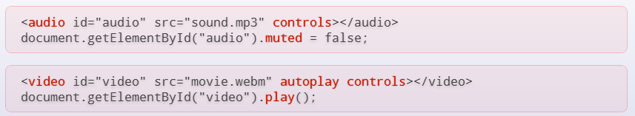
Audio + Video

Slide 43
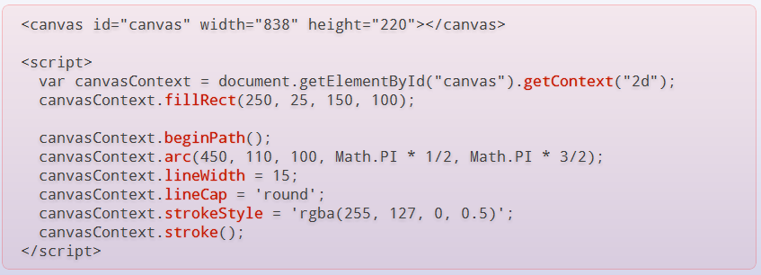
Canvas 2D

Slide 44
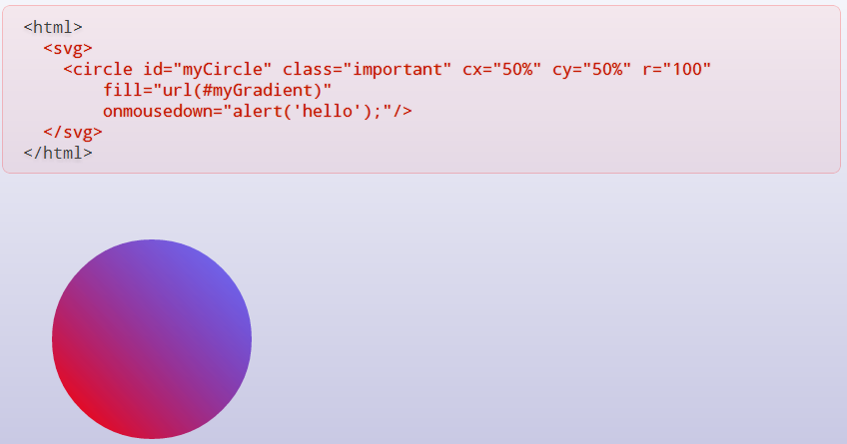
Inline SVG

Slide 45

CSS 3.0

Slide 46
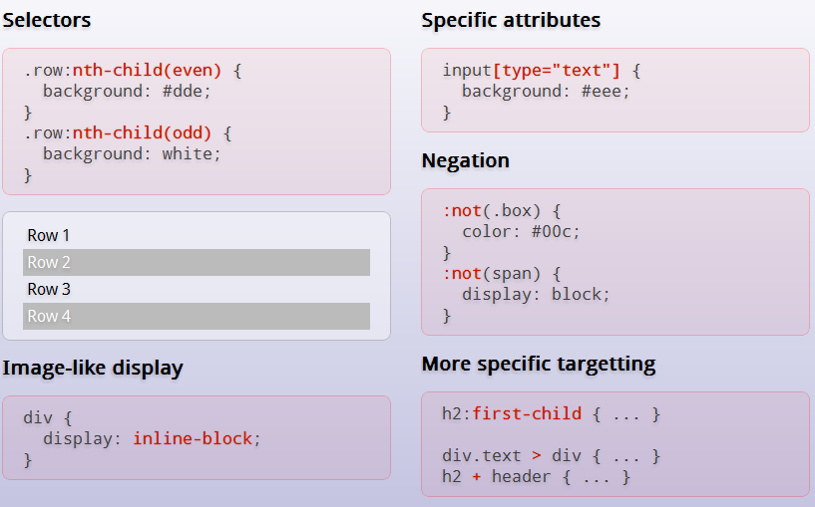
CSS Selectors

Slide 47
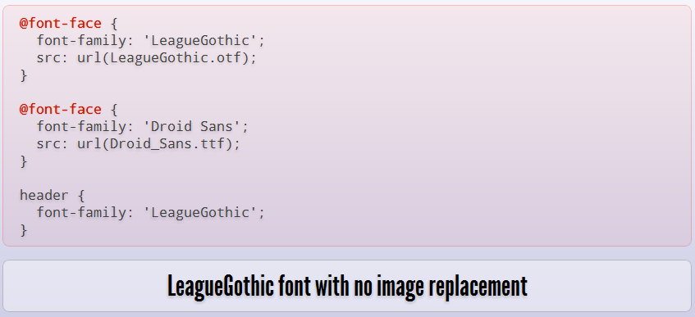
Web Fonts

Slide 48
More…
Columns
Opacity
Text Stroke
Text Wrapping
Hue/saturation/luminance color
Rounded corners

Slide 49
And More…..
Gradients
Shadows
Background enhancements
Border image
Flexible Box Model
Transitions , Transforms & Animations

Slide 50

File/Hardware Access

Slide 51
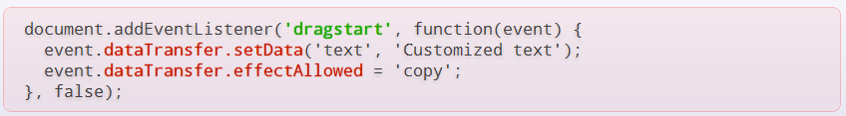
Native Drag & Drop

Slide 52
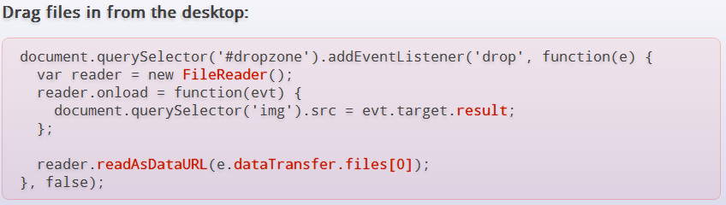
Desktop Drag-In (File API)

Slide 53
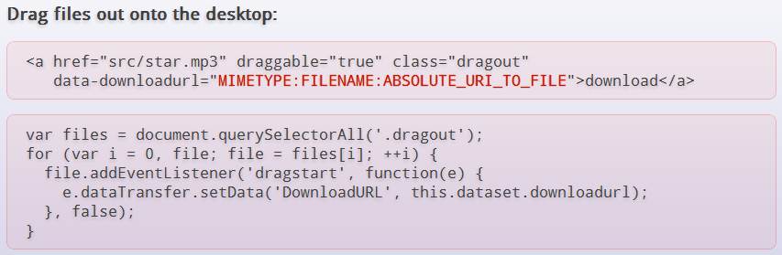
Desktop Drag-Out

Slide 54
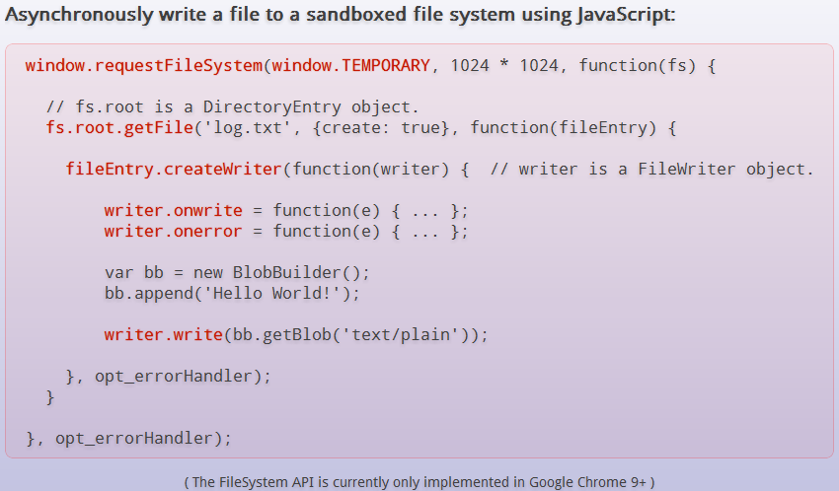
FileSystem APIs

Slide 55
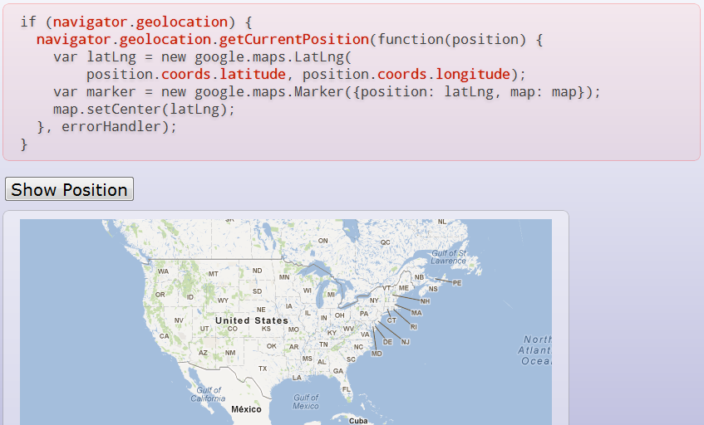
GeoLocation

Slide 56
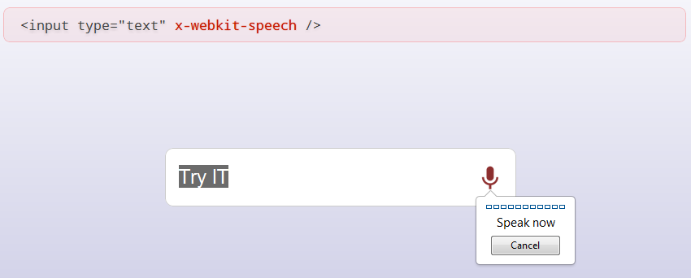
Speech

Slide 57
Q&A

